Slide 1
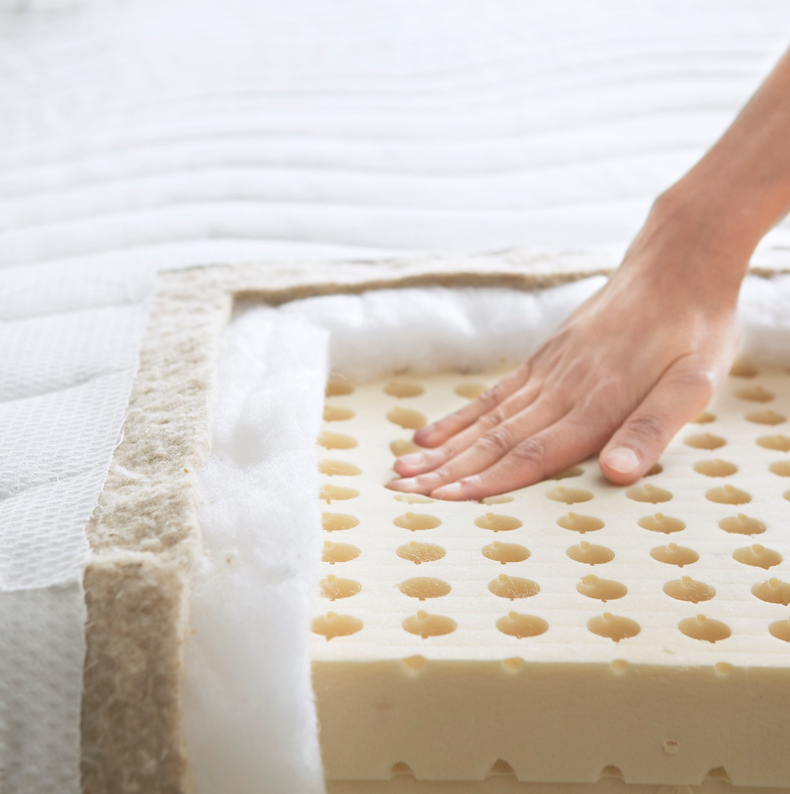
Project Mechanical Recycling of Post-Consumer Mattresses
Category
Filled products
Ingrida
2020 07

Slide 2
The average household keeps their mattress for 7 years before seeking out a replacement for it.

Slide 3
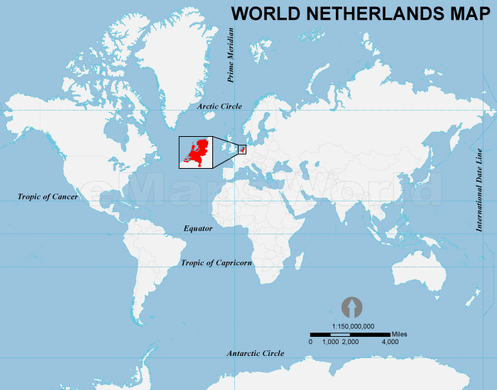
1,5 million mattresses are collected for disposal in the Netherlands each year.
How many of them in the world?

Slide 4
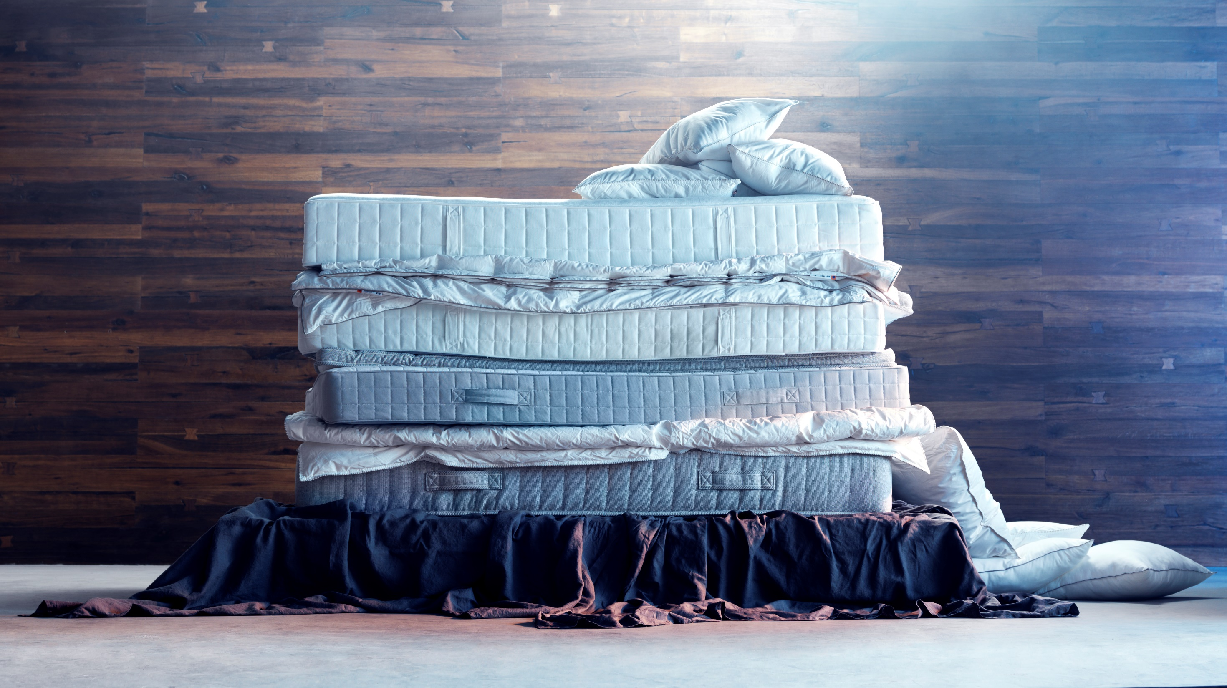
Is it possible to recycle?

Slide 5
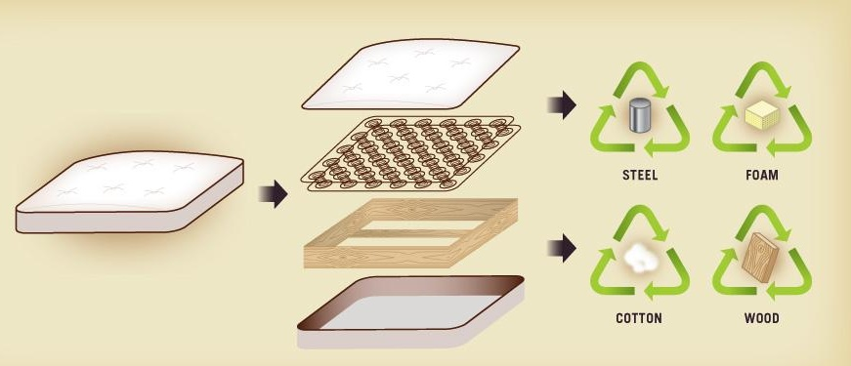
Photo source: https://sleeponlatex.com/blogs/news/14319429-100-places-to-recycle-your-old-mattress?utm_medium=Social&utm_source=Pinterest

Slide 6
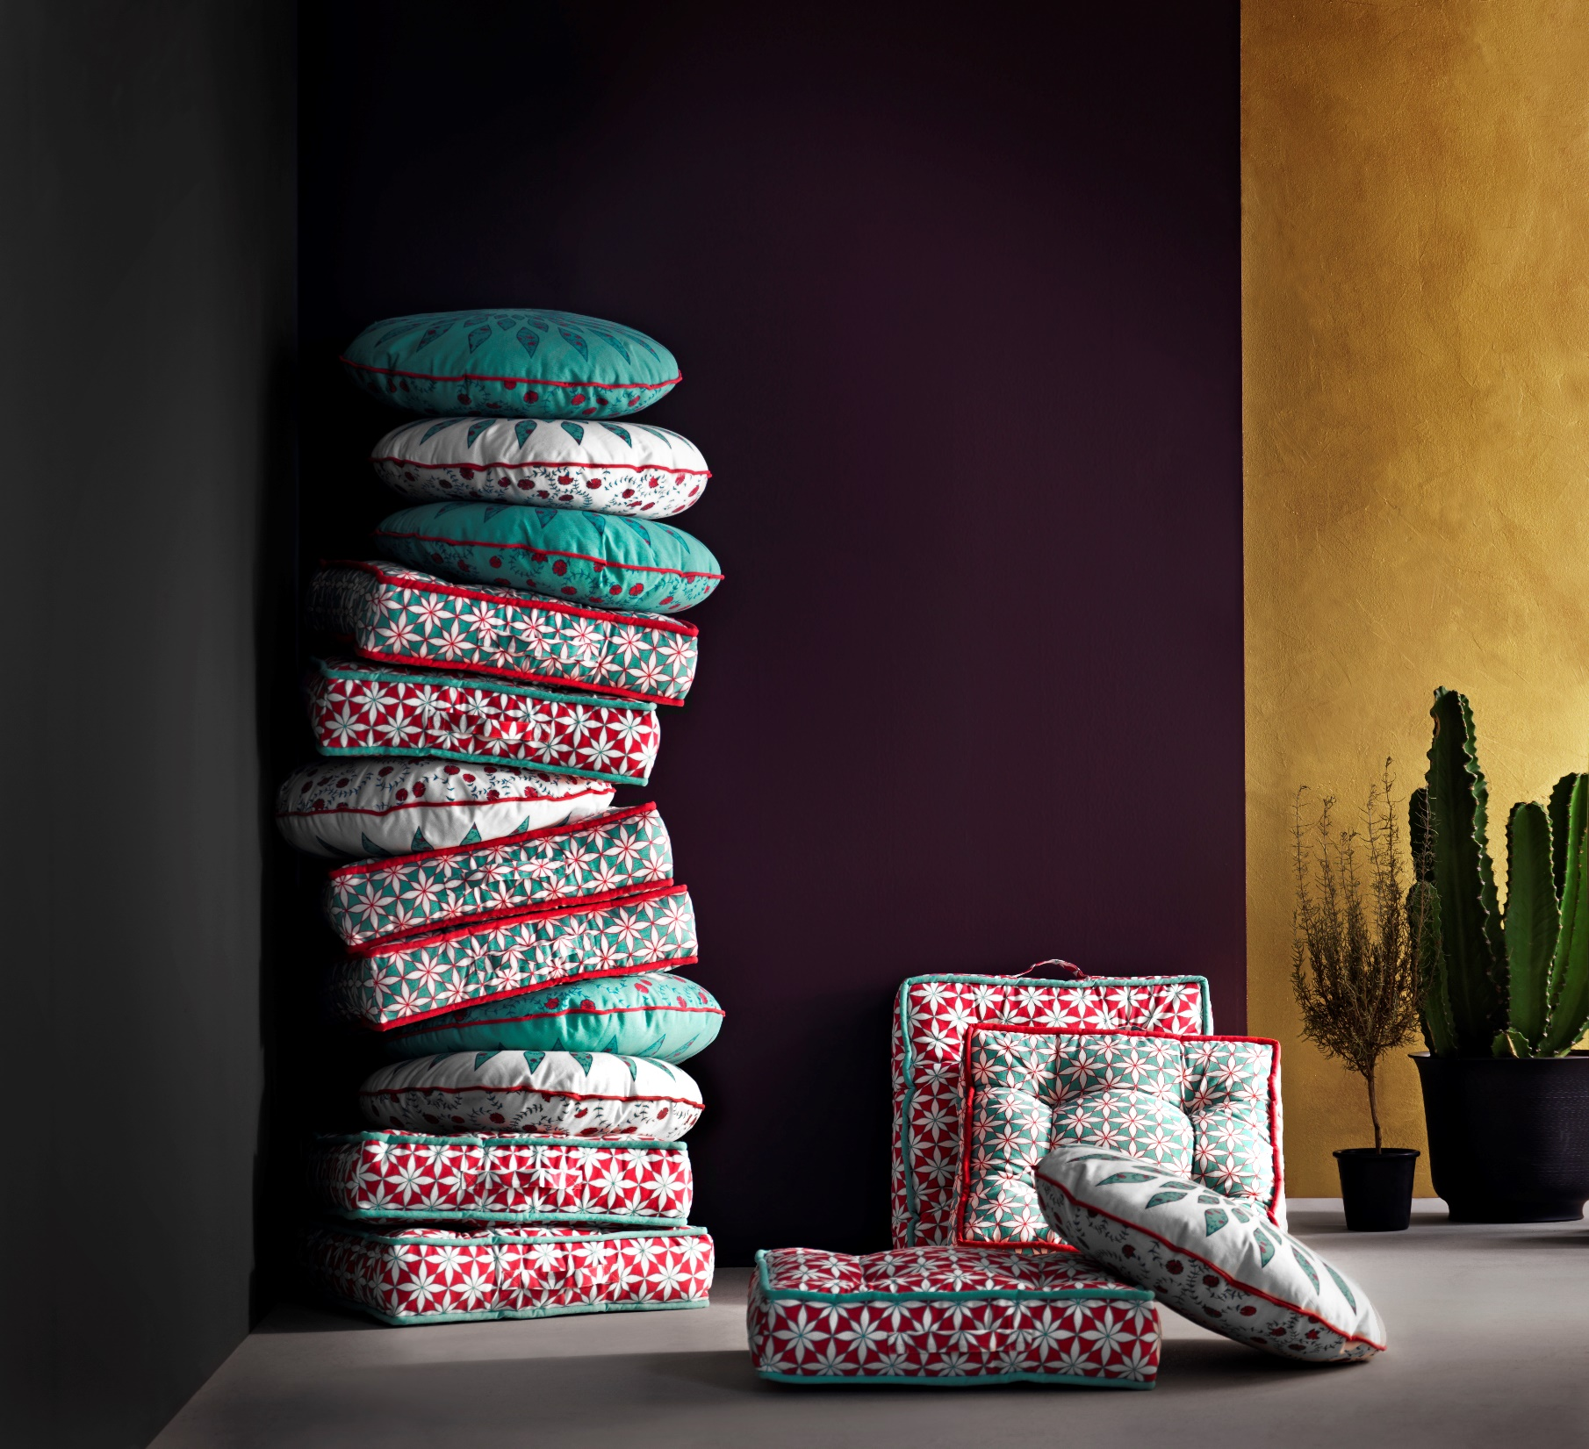
Foam can be shredded and used in floor cushions.

Slide 7
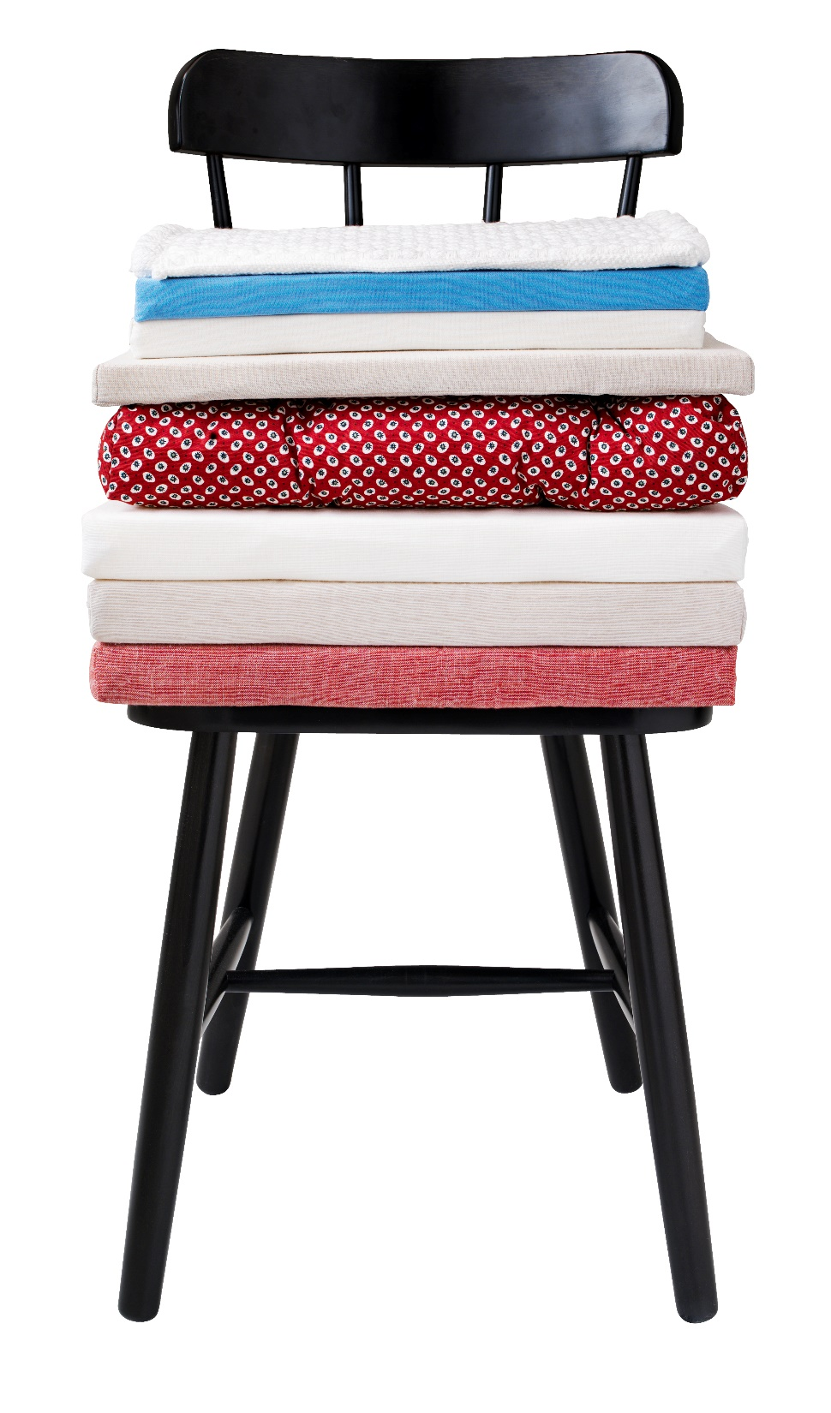
The shredded foam pieces can be compressed and bonded together creating the
rebonded foam for chair pads.

Slide 8

GOAL
Use mechanically recycled post-consumer foam in
filled products and decrease the filling cost

Slide 9
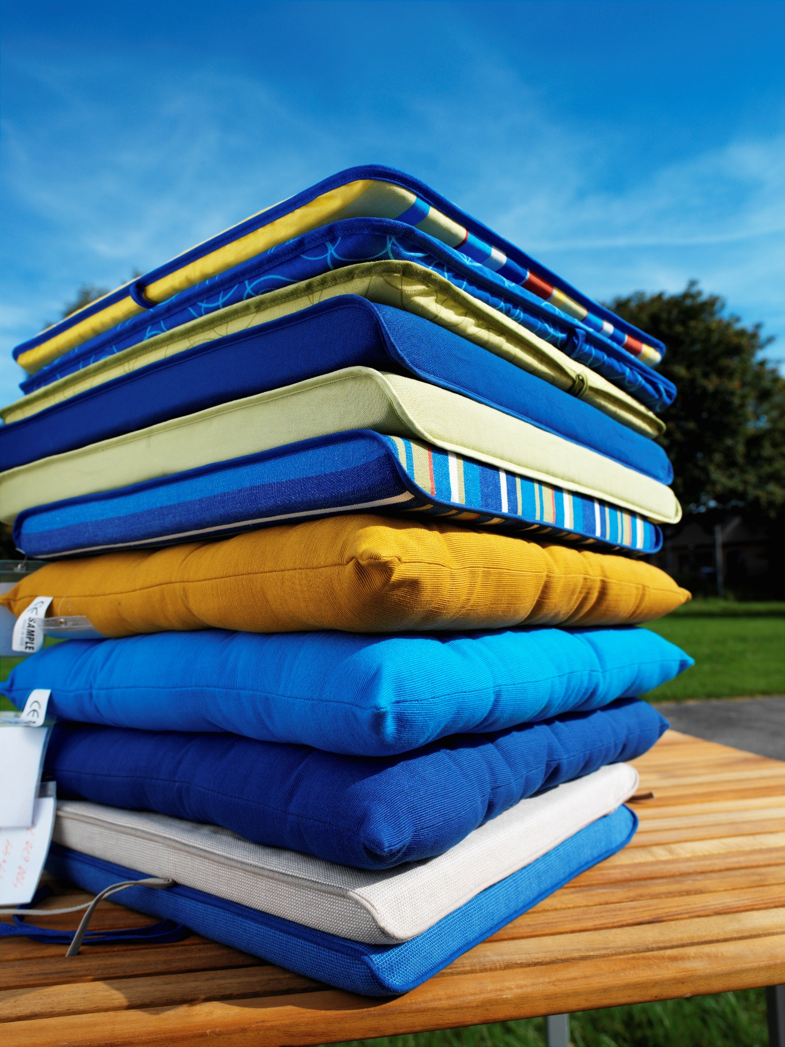
WHY?
Reduce solid waste that goes to landfill
Save energy in production
Prevent pollution
Become independent on virgin resources
Lower price filling
Lower final product price
Be responsible and showing good
example

Slide 10
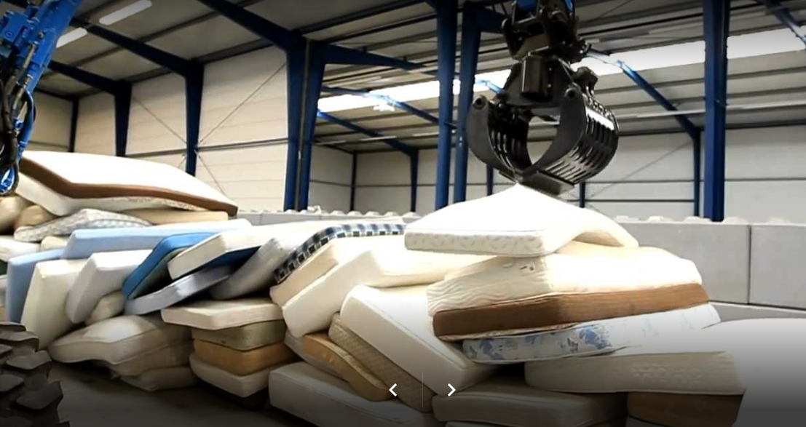
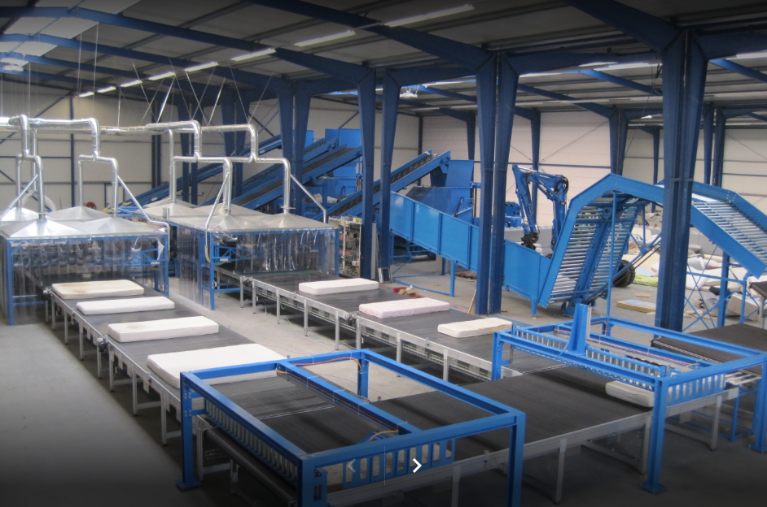
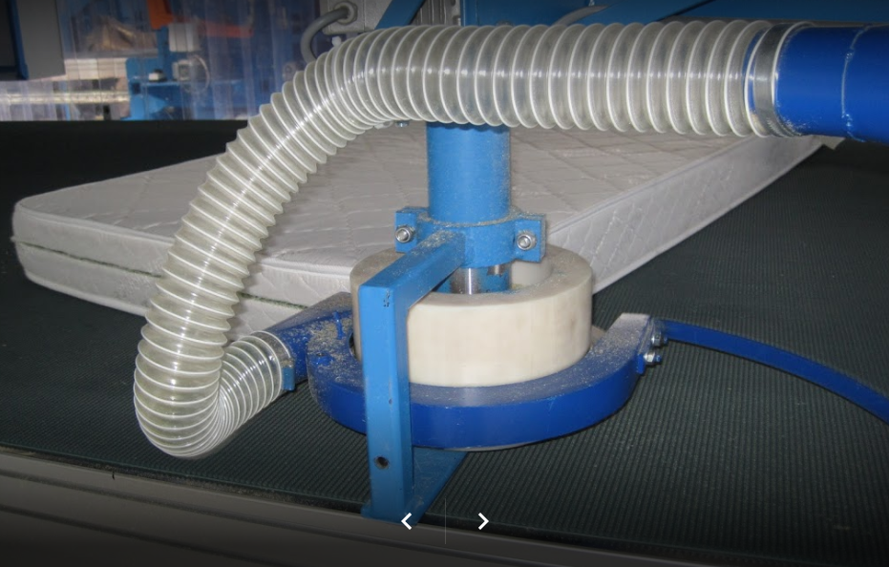
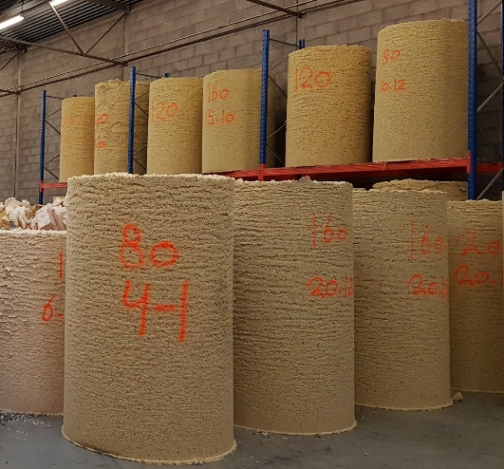
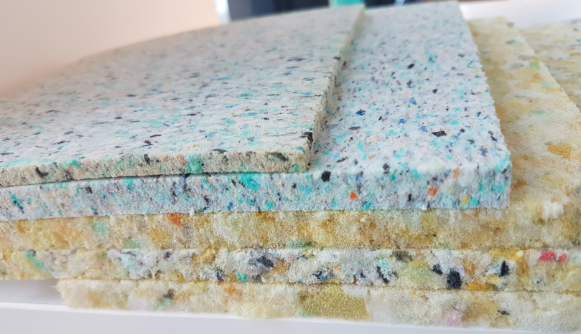
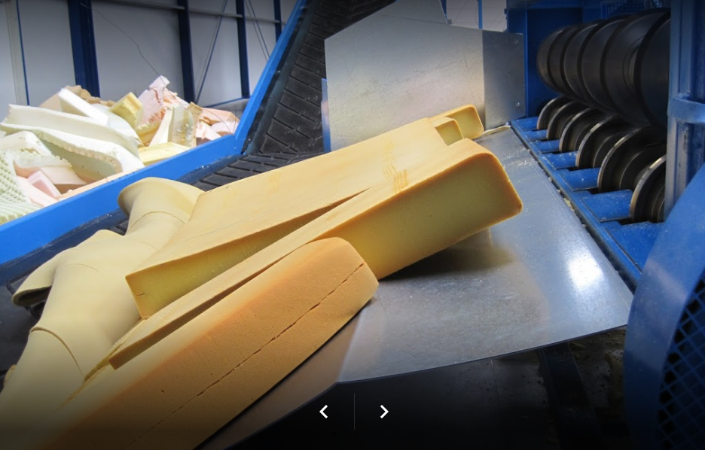
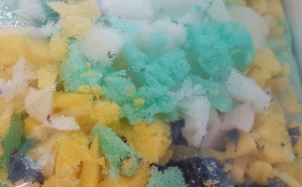
HOW?

Slide 11
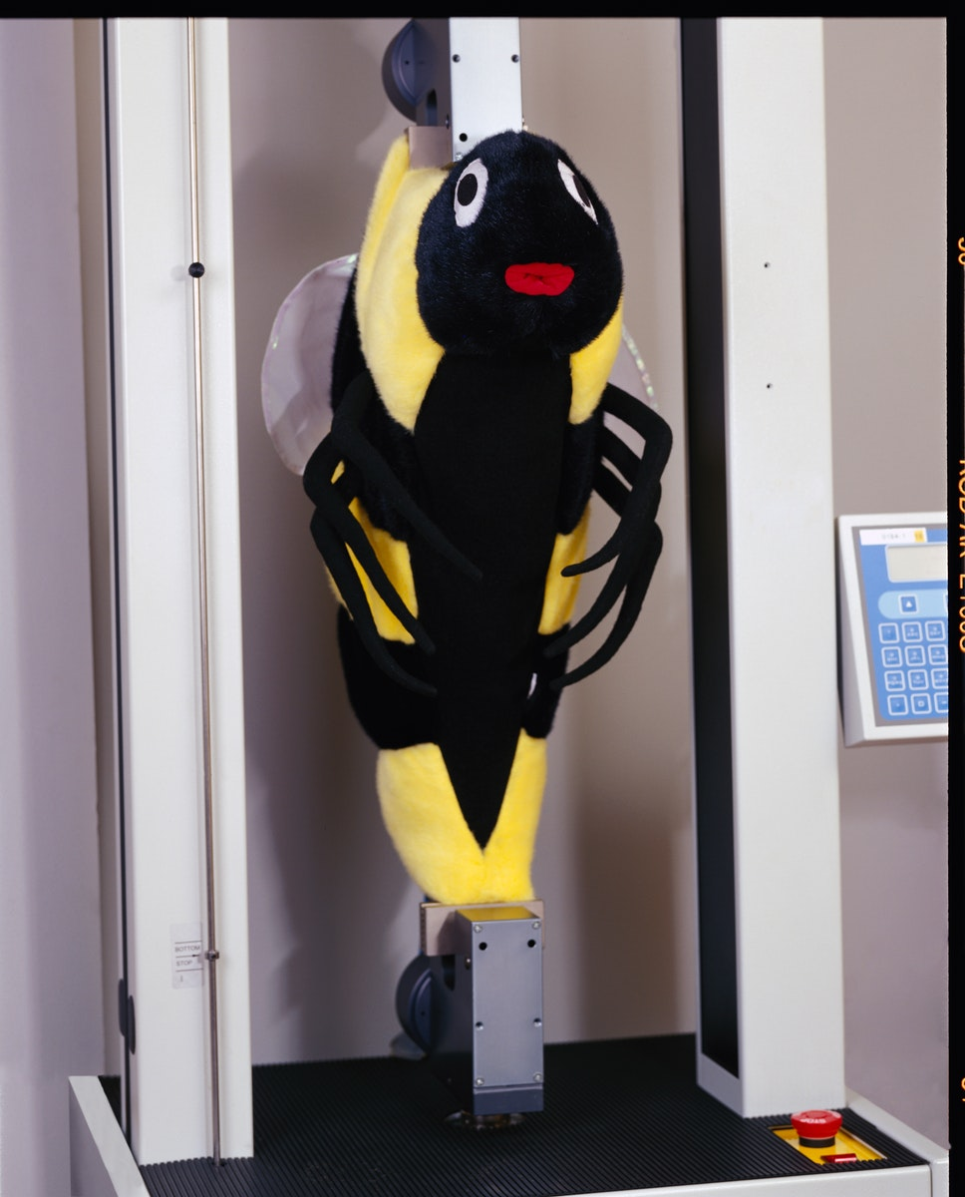

Brainstorming: opinion, ideas, experience
What additional requirements must be for post-consumer foam
Available labs for making tests. Test new and recycled foam (for comparison)
Regular foam samples from suppliers
Pilot supplier for production of samples with regular and recycled foam.
Workshop with engineers

Slide 12
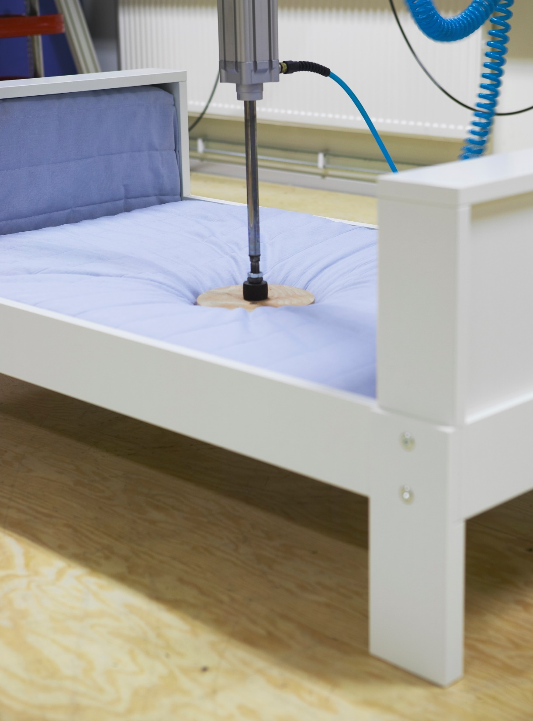
RISK ASSESMENT
Chemical risk
Restricted substances might be in post-consumer mattress of different brands.
ACTION: More frequent tests should be performed.
Hygiene risk
Bacteria, viruses, mold, fungi, soil, dust, fats, organic debris.
ACTION: Cleanliness tests need to be performed to evaluate how well the foam
has been sterilized.
Quality risk
Same requirements must be fulfilled as virgin foam.
Radiant risk
The detectors must be installed in the recycling companies.

Slide 13

MAT-0010
RISK ASSESMENT
TEST DESCRIPTION
1. General Requirements for all materials
Biocides of all kinds (formulation review)
Cadmium and its compounds
CMR substances categories 1 or 2 (on preparation or mixture, NOT finished product) (formulation review)
SVHC
Fragrance (formulation review)
Lead and its compounds
2.5 Polyurethane foam
2,4 Toluenediamine (2,4-TDA), 2,6 Toluenediamine (2,6-TDA), 4,4 Diaminodiphenylmethane (4,4-MDA)
Chlorinated hydrocarbon solvents
Chlorinated paraffins (SCCP)
Flame retardants
Total Antimony content
Organic brominated compounds (PBBs, PBDEs)
Chlorinated paraffins (SCCP)
TEPA (tris-(aziridinyl)phosphine oxide)
TDCP, TCEP & TPP (Tris(1,3-dichloro-2-propyl) phosphate), Tris-(2-chloroethyl) phosphate, Triphenyl phosphate)
Organotin compounds
Phthalates (18P)
Chemical risk
Restricted substances might be in post-consumer mattress of different brands.
ACTION: More frequent tests should be performed.
How frequent?

Slide 14
RISK ASSESMENT
Hygiene risk
Bacteria, viruses, mold, fungi, soil, dust, fats, organic debris.
ACTION: Cleanliness tests need to be performed to evaluate how well the foam has been sterilized.
What tests to perform?
Test foam according to the down&feather cleanliness standard:
EN 12935 Cleanliness Requirements for Down & Feathers:
EN 1162 Oxygen Number
if Oxygen Number > 20 then
Microbiological State - Bioburden EN 1884 must be tested
Optional:
EN 1164 Turbidity
EN ISO 3071 pH Value
IDFL 30 - down & feather Odour test or
GB 18401 Textile Odor test
ISO 17226 Formaldehyde

Slide 15
RISK ASSESMENT
Quality risk
Same requirements must be fulfilled as virgin foam.

Slide 16
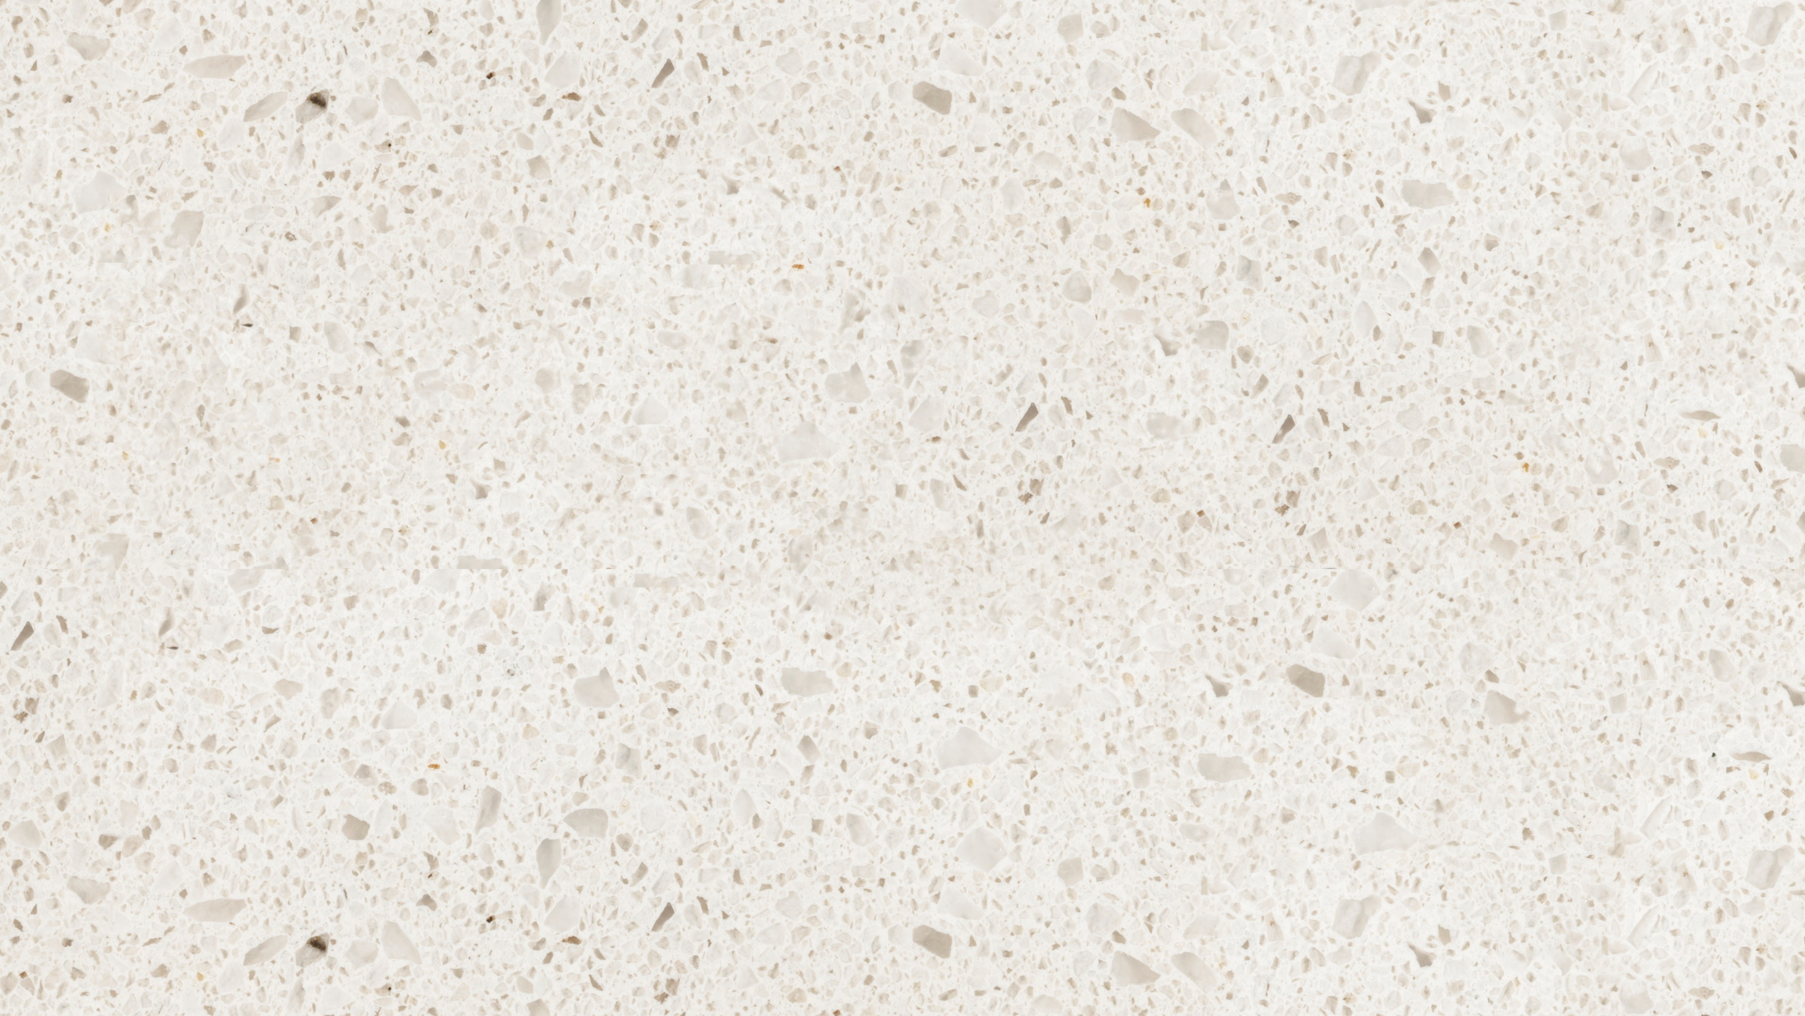
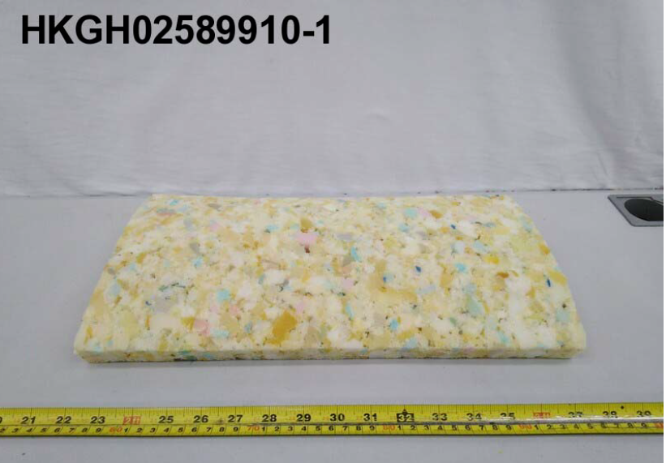
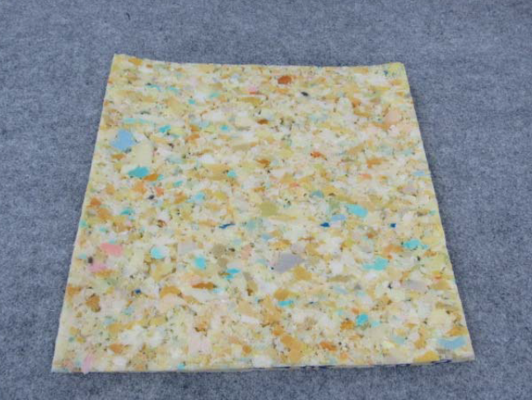
PROJECT RESULTS
Mechanically Recycled bonded foam from post-Consumer Mattresses were tested in Intertek.
Chemical tests according IOS-MAT-0010 and IOS-PGR- 0029 were performed.

Slide 17
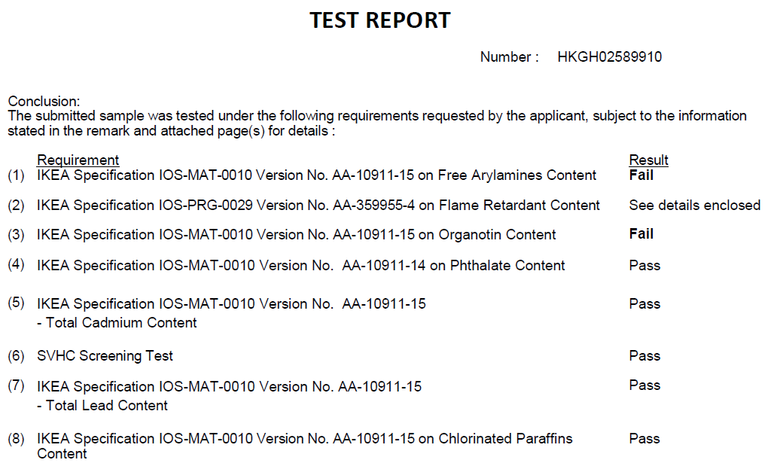
(9) Ash content (EN ISO 11358:1997, 70C) Pass

Slide 18
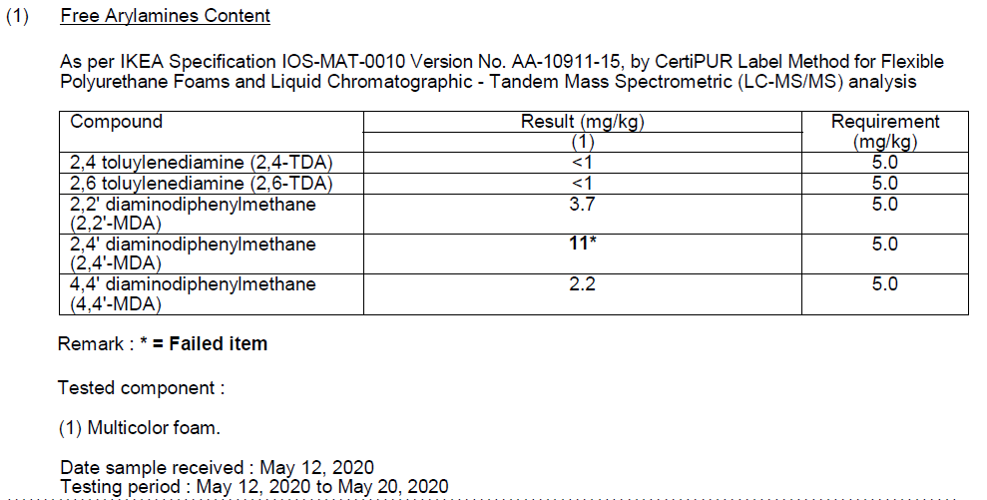
Failed – Free Arylamines content – 2,4 MDA

Slide 19
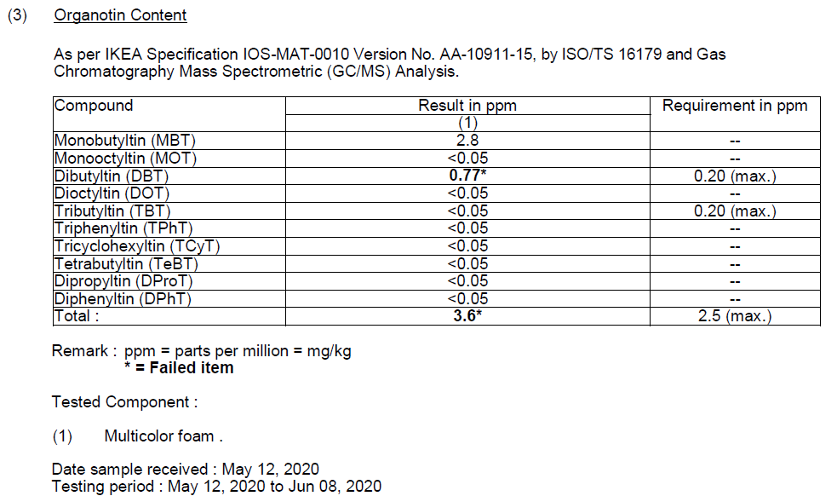
Failed – Organotin content – DBT and total

Slide 20
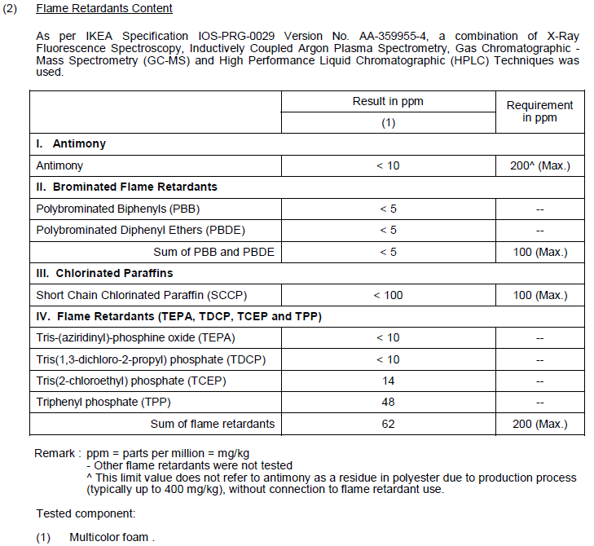
PASSED - Flame retardants content

Slide 21
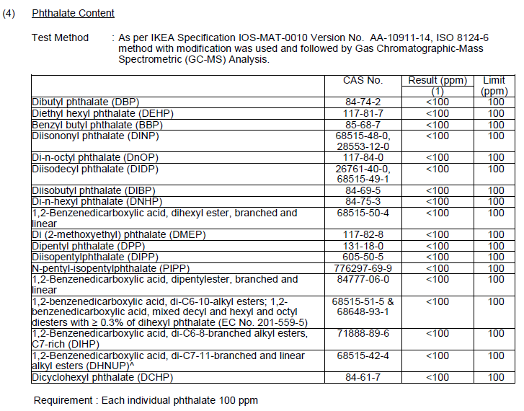
PASSED – Phthalate content

Slide 22
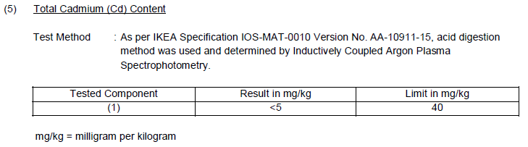
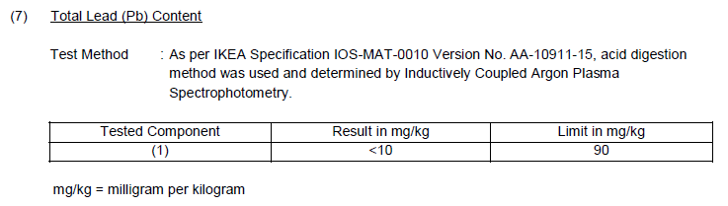
PASSED – Total Cadmium (Cd) and Total Lead (Pb) content

Slide 23
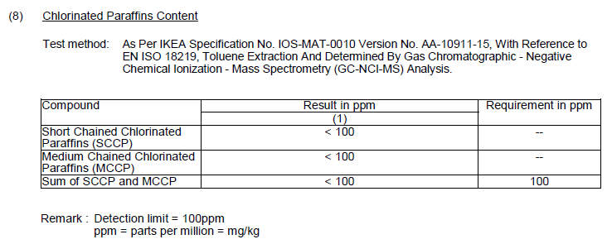
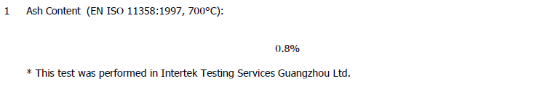
PASSED – Chlorinated Paraffins Content and Ash content

Slide 24
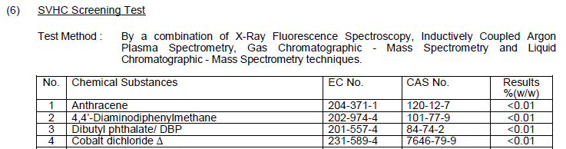
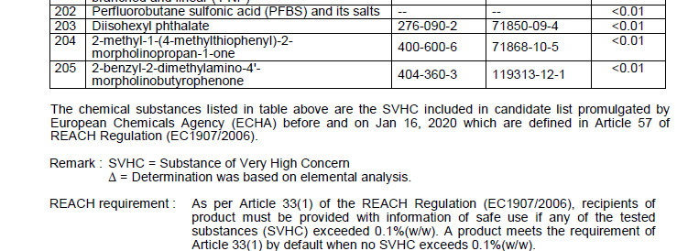
PASSED – 205 SVHC
…

Slide 25

Conclusions
Mechanically recycled bonded foam from post-consumer mattresses do not meet IKEA requirements described in IOS-MAT-0010.
Failed – Free Arylamines content – 2,4 MDA
Failed – Organotin content – DBT and total organotin
2,4 MDA and organotin can not be eliminated by mechanical recycling process from the foam
Hygienic tests were not performed as chemical tests failed
Mechanically recycled bonded foam from post-consumer mattresses can not be used in IKEA filled products
Financial part – 2700 Eur (tests, Retour Mattress visit in NL)
Photo source: https://geteasymove.com/blog/the-best-practical-ways-how-to-get-rid-of-mattress

